Slide 1
Morent Car Rental
Name:
Abdu Subhan
Email:
abdusubhan6678@gmail.com
Project:
Morent Car Rental MarketPlace

Slide 2
About me
Hi, I’m Abdu Subhan, a passionate Frontend Developer with 1+ year of experience in building user-friendly, responsive, and visually engaging web applications. I specialize in modern technologies like HTML, CSS, Nextjs, React, TypeScript, Tailwind CSS, and GSAP animations to create seamless user experiences.
I have a proven track record of delivering high-quality projects, including:
Marketplace CR Rental Application: Developed a dynamic platform for car rentals, integrating advanced features and tackling complex challenges like performance optimization and API integration. (https://the-morent-car-rent.netlify.app)
Portfolio Website: Showcasing proficiency in responsive design, animations. (https://the-subhan-portfolio.netlify.app)
I take pride in my ability to understand client needs, craft tailored solutions, and continuously learn and adapt to new challenges in the tech space.

Slide 3

MORENT CAR RENATL
"Your Ride, Your Rules."
Secure Payment Integration with Stripe
Integrated Stripe Payment Gateway offers:
Secure transactions with encryption.
Multiple payment options (credit cards, debit cards, Apple Pay, Google Pay).
Transparent Pricing
Clear breakdown of rental costs,No hidden charges, ensuring trust and loyalty.

Slide 4
Work flow of Morent Car Rental
Show to user through UI
Morent Car Rental
User
Request
Sanity
(CMS)
Response

Slide 5
Why Choose Us?:
Customer Benefits?
Wide range of cars: From budget-friendly cars to luxury rides.
Competitive pricing: Transparent rates with no hidden charges.
Easy booking process: User-friendly platform for seamless reservations.
Flexible rentals: Daily, or long-term options.
Secure payments: Powered by Stripe for safe and hassle-free transactions.
Pricing: You can sort the cars using pricing range.
Convenience: Book anytime, anywhere with an intuitive interface.
Flexibility: Customize your rental period and vehicle preferences.
Affordability: Best-in-market rates with no compromise on quality.
Safety: All vehicles are insured and maintained regularly.

Slide 6

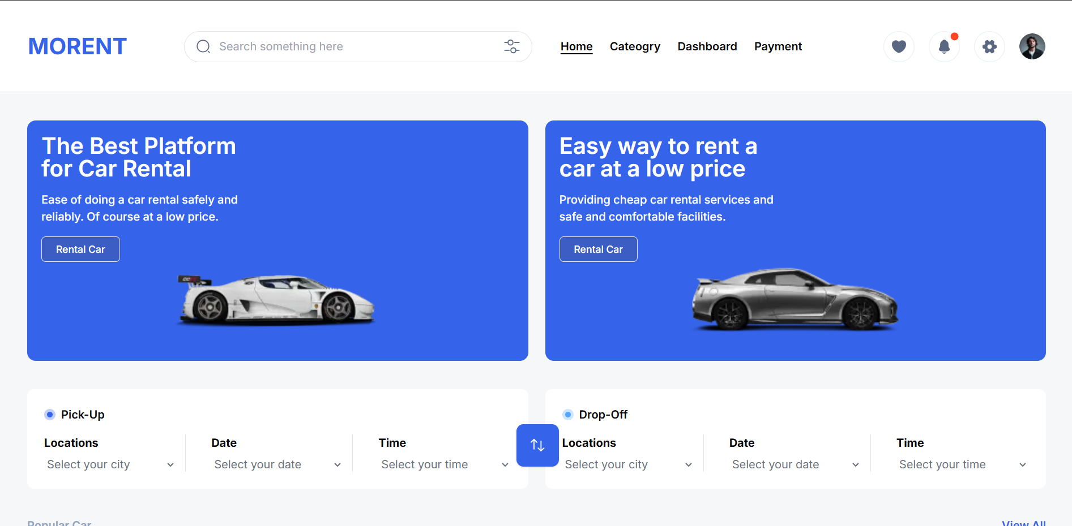


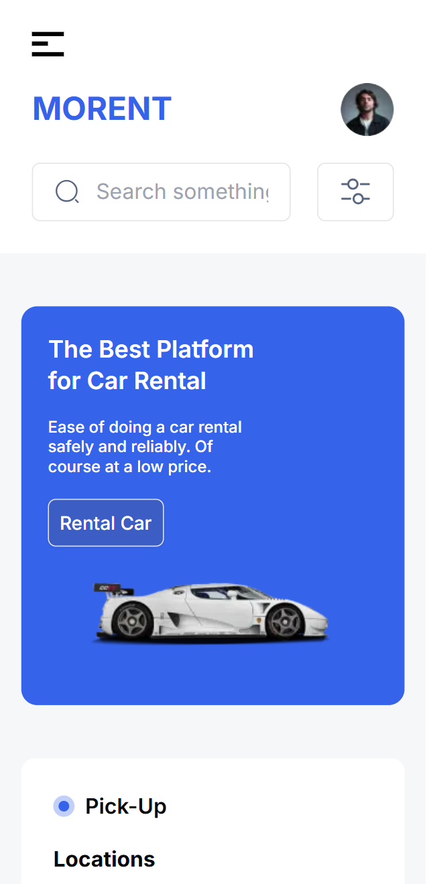
Morent Car Rental
Features:
List key features of Morent Rental:
Search and Filter: Find cars by type, price, or location.
Real-time Availability: Ensure up-to-date booking options.
Responsive Design: Works on mobile and desktop.
Secure Payments: Multiple payment options with encryption.
User Profile: Manage bookings and history.

Slide 7
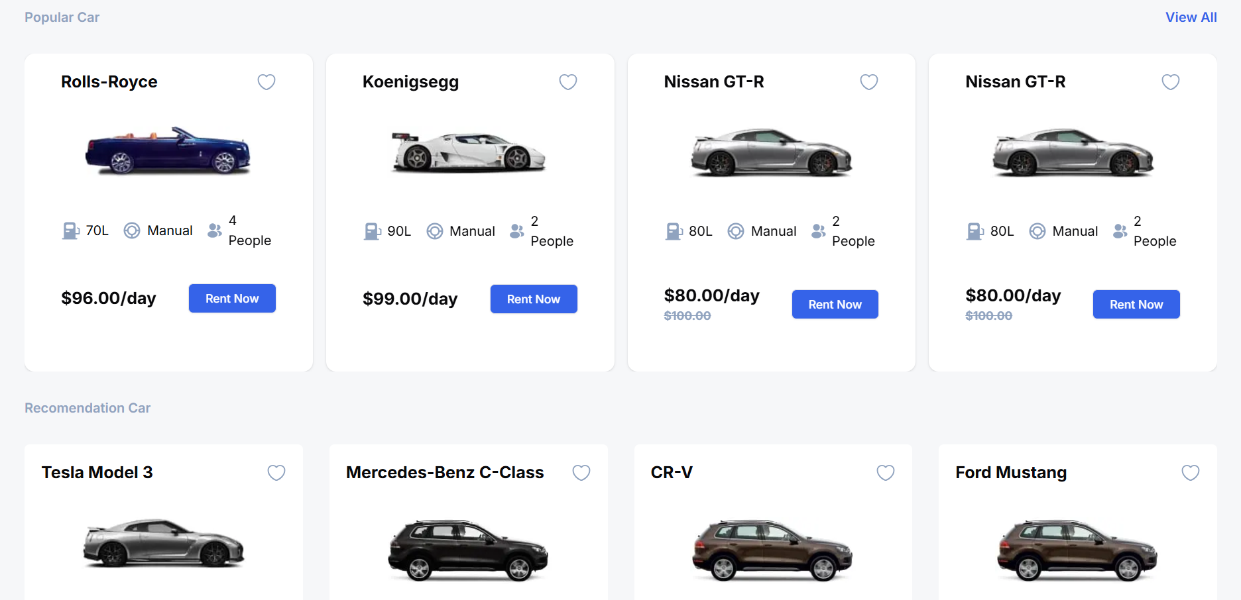
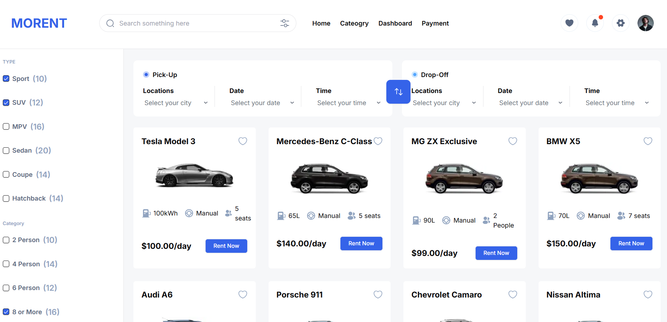
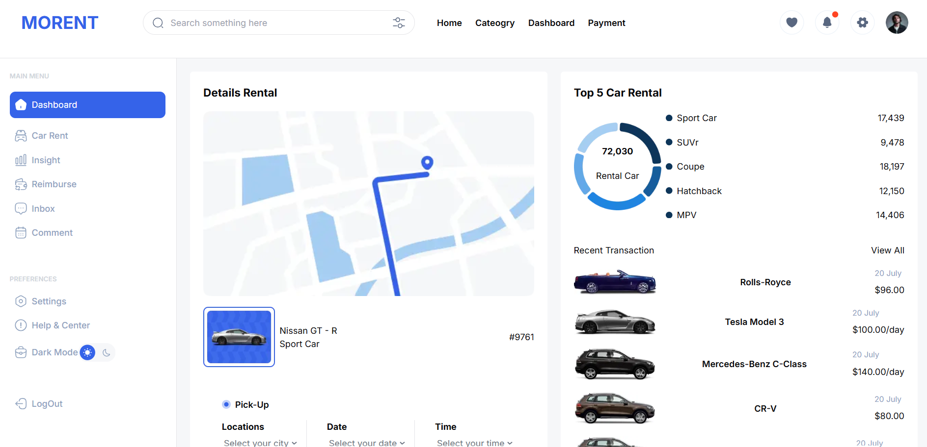
Performance Optimization
Technology Stack
Frontend: Next.js, Tailwind CSS
Database: Sanity
Hosting: Netlify
Lazy loading for images.
Caching strategies.
API response optimization.

Slide 8
Future Growth Plans
Expanding to additional cities and regions.
Introducing electric and hybrid car rentals.
Adding subscription-based rental options.
Partnering with local businesses for exclusive deals.
Implementing AI-based recommendations for enhanced user experience
Target Audience
Business travelers seeking reliable transportation.
Families needing spacious vehicles for trips.
Individuals exploring luxury cars for special occasions.
Tourists looking for convenient and affordable travel options.

Slide 9
Contact
Abdu Subhan
abdusubhan6678@gmail.com
Drive the road to freedom with us. Book your next ride today!

